Slide 1
On Spectrum Sensing, an ML Method for Cognitive Radio Systems
-Youness Arjoune and Naima Kaabouch
Ishan Jha - IMT2022562 Aryan Mishra - IMT2022502
https://github.com/Ishaniiitb/On_Spectrum_Sensing_Using_ML

Slide 2
Understanding the problem
01
Radio spectrum is a limited resource that needs to be well managed. Dramatic growth of wireless communication has created a deficit of available radio spectrum.
02
Federal Communications Commission (FCC) policies are based on static management of spectrum, in which they are divided and doled out
03
Existing dynamic spectrum management systems have certain drawbacks with respect to signal-noise power ratio, computational complexity and others.

Slide 3
Proposed Solution
A two step machine learning model for spectrum sensing :
K-means algorithm(Unsupervised learning) is used to identify the state of the primary user present.
Different supervised ML classifiers like SVM, KNN, Naive Bayes and Random Forest are used.

Slide 4
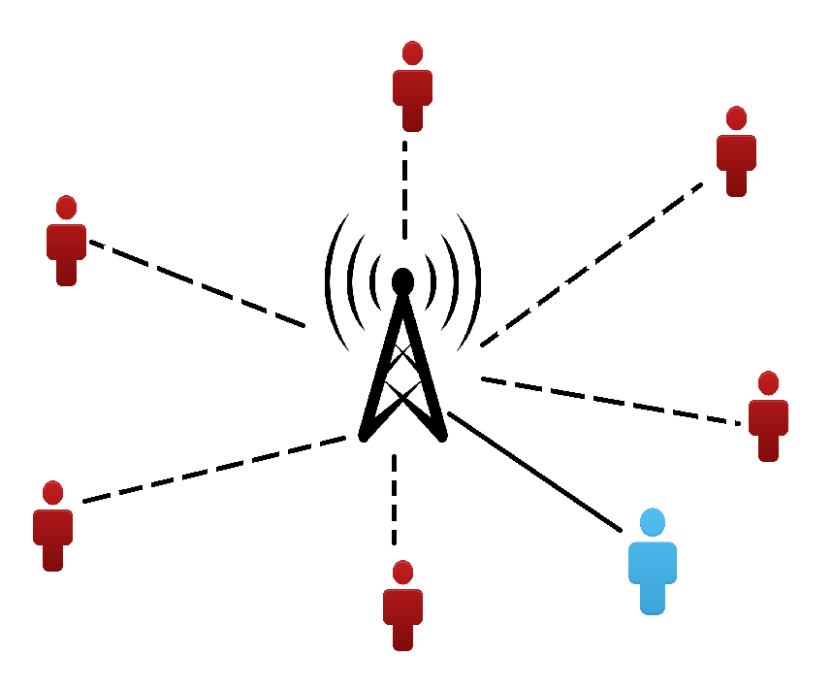

Proposed System Design

Slide 5
Methodology

Slide 6
A. Spectrum Sensing

Slide 7


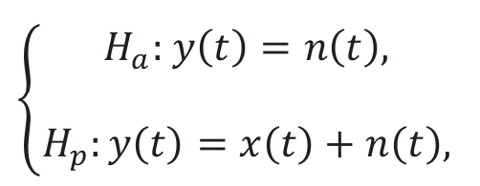

A. Spectrum Sensing
In the given equations, y(t) represents the received signal, n(t) represents the noise present and x(t) represents the signal transmitted by the primary user (PU)

Slide 8
B. Energy Statistics

Slide 9
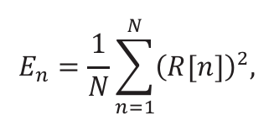
B. Energy Statistics (cont.)
The formula which we use to obtain the energy statistics is :
In the above formula, E_{n} represents the average energy statistic of received signal, n represents the number of sample, and R[n] represents the n^{th} element of the vector formed by the fast fourier transform (FFT) of the received samples.

Slide 10
B. Energy Statistics (cont.)
04
1. Feeding Data
4. Outputs
Feed unlabelled dataset to unsupervised model (K-means clustering).
Supervised models can now generate desired outputs.
01
03
2. Classification
3. Supervised
Unlabelled dataset is now classified into clusters by unsupervised model.
After obtaining the labelled data, we can now feed it to the supervised ML models.
02

Slide 11
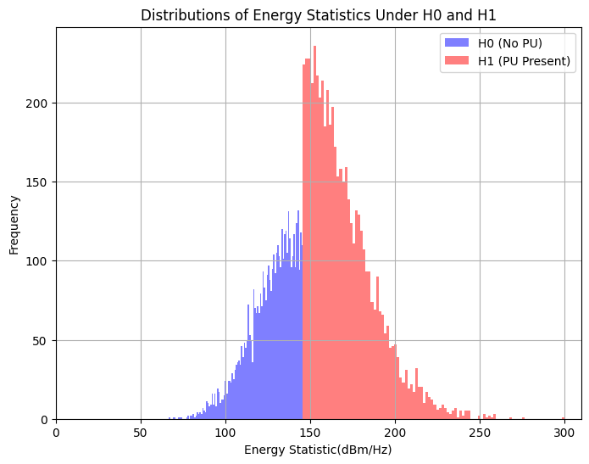
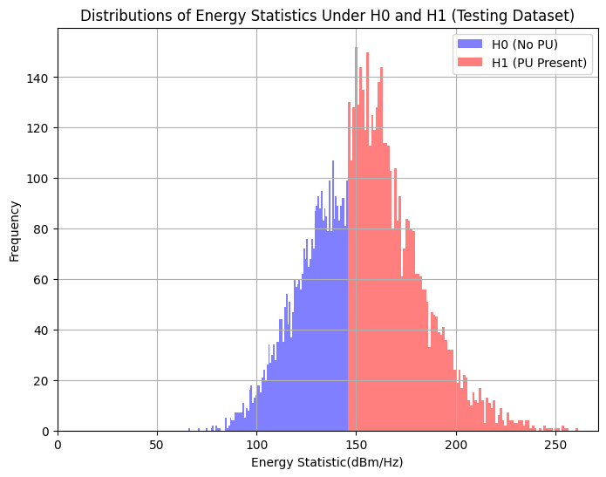
Synthetic Data Generation
We generate two separate datasets, one for training the model and the second for testing the accuracy of the various models.
Training data
Testing data

Slide 12
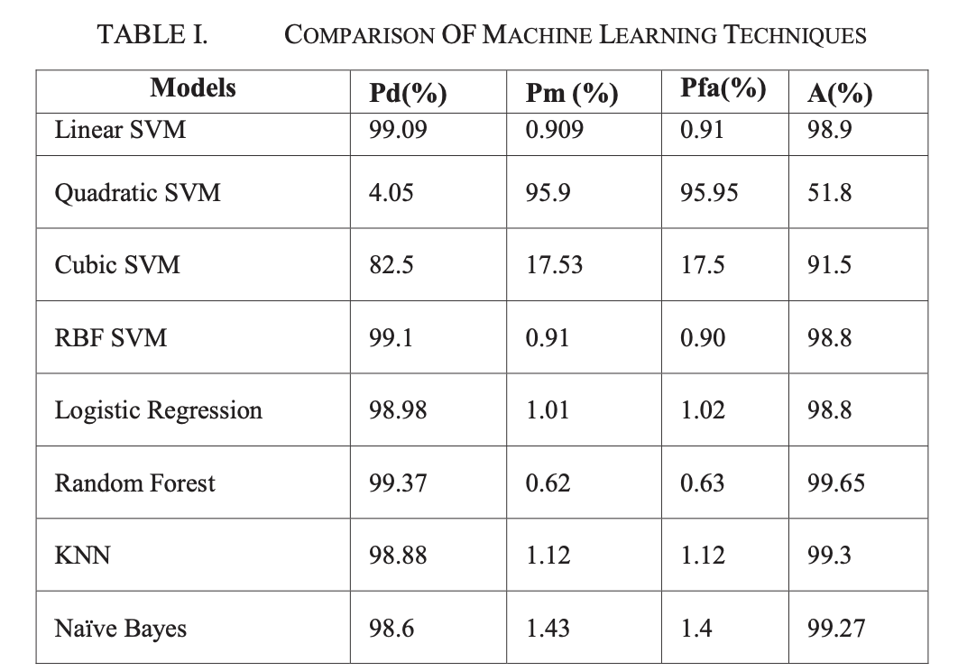
Theoretical Results

Slide 13
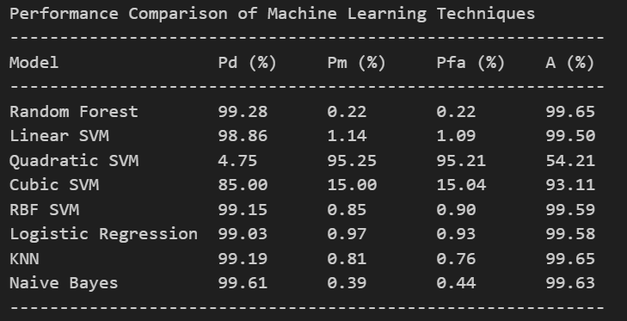
Obtained Results

Slide 14
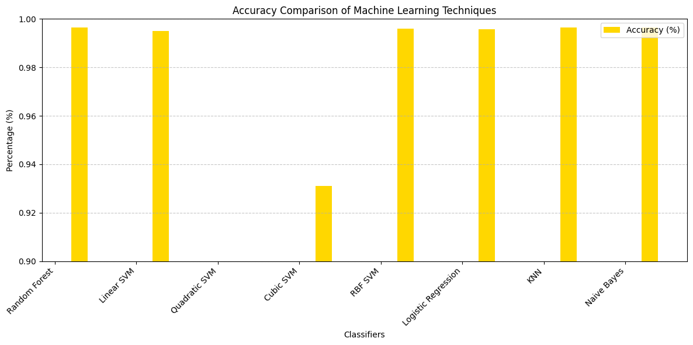
Accuracy Comparison with respect to Accuracies

Slide 15
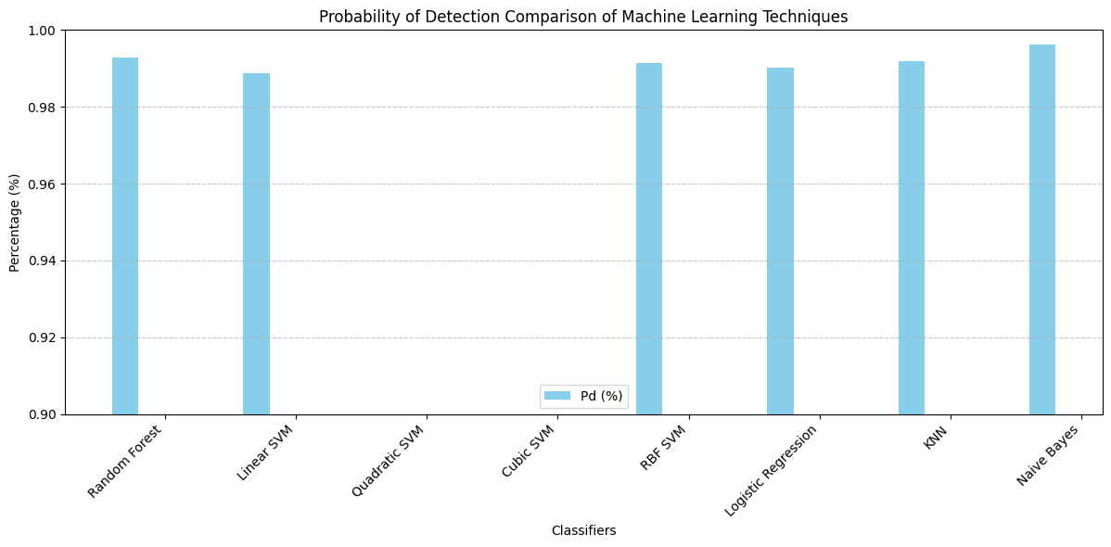
Probability of Detection Comparison with respect to Accuracies

Slide 16
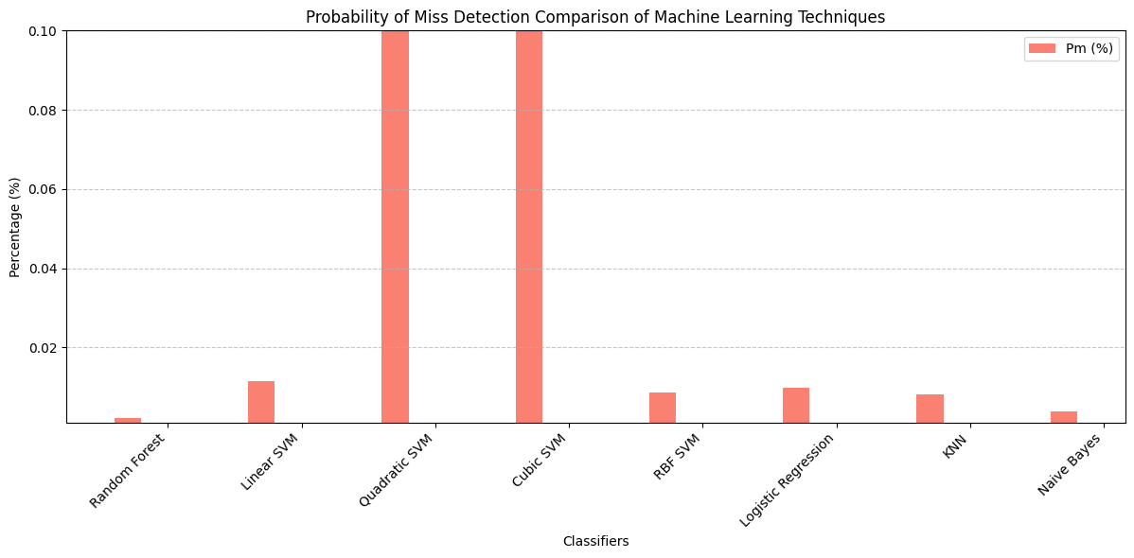
Probability of Miss Detection Comparison with respect to Accuracies

Slide 17
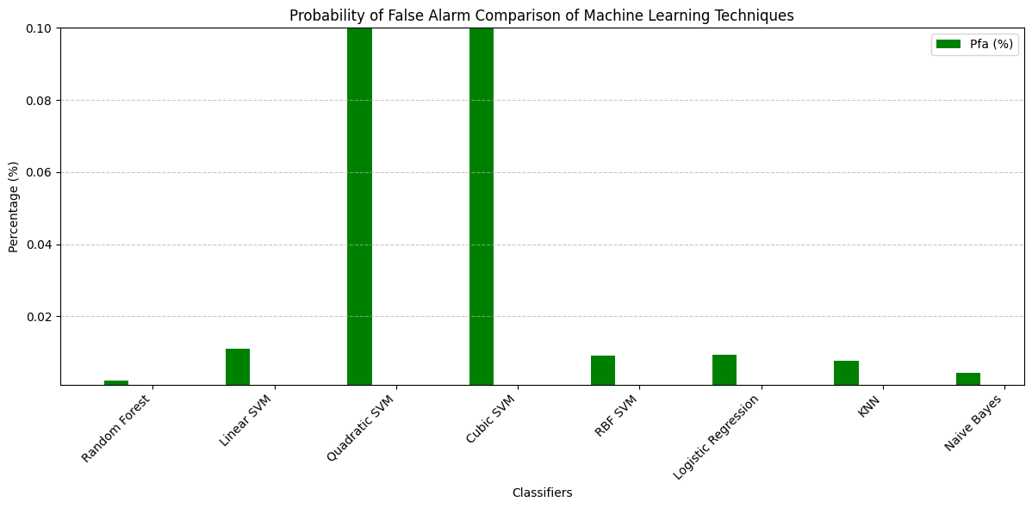
Probability of False Alarm Comparison with respect to Accuracies

Slide 18
Inference
Best performing model:
→ Random Forest achieves the highest overall performance, balancing high detection rates with low false positives and miss-detections, making it the most reliable for spectrum sensing.
Strong alternative:
→ KNN almost replicates the random forest classifier.
Other models:
→ RBF SVM and Linear SVM give strong results too though Quadratic and Cubic SVMs struggle significantly.
→ Although, logistic regression is competitive it still lags behind Random Forest.

Slide 19
Possible Improvements
Improve labelling accuracy
→ Explore Gaussian Mixture Models (GMM) for better handling of overlapping signal and noise distributions.
Add Cyclostationary Features
→ Enhance the energy statistic with cyclostationary features to capture signal periodicity, boosting classification performance in low SNR conditions.

Slide 20
Future Scope/Extension

Slide 21
Spectrum Sensing for Home Wifi Networks
Objective:
→ Extend the current spectrum sensing model to help home Wi-Fi routers detect and switch to less crowded channels, improving internet performance for users.
→ Enable Wi-Fi routers to automatically find the best available channel to reduce interference from neighboring networks.

Slide 22
Method:
→ Channel Scanning: Modify the model to scan common Wi-Fi frequency bands (2.4 GHz and 5 GHz) every few minutes to measure signal strength and noise levels.
→ Interference Detection: Use the existing energy statistic feature to identify channels with high interference (e.g., from nearby routers or devices).
→ Channel Switching: Program the router to switch to the least congested channel automatically when interference exceeds a simple threshold (e.g., signal-to-noise ratio drops below 20 dB).
→ User Notification: Add a basic alert feature to notify users via the router’s app when a switch happens, keeping them informed without technical details.

Slide 23
How to implement:
→ Update the generate_dataset function to simulate Wi-Fi signal data with varying interference levels.
→ Train the Random Forest classifier on this data to predict the best channel.
→ Integrate the model with a simple router API to apply the predicted channel switch in real-time.
Benefit:
→ Improves home internet speed and reliability by avoiding crowded channels, making it easy for non-experts to use.

Slide 24
Thank You!

